Slide 1
CURLS: Causal Rule Learning for Subgroups with Significant Treatment Effect
Jiehui Zhou^{1,2}, Linxiao Yang², Xingyu Liu¹, Xinyue Gu², Liang Sun² and Wei Chen¹
¹ State Key Lab of CAD&CG, Zhejiang University
² DAMO Academy, Alibaba Group
Notes:
Hello, my name is Linxiao Yang, and I’m very glad to present this paper: CURLS: Causal Rule Learning for Subgroups with Significant Treatment Effect

Slide 2
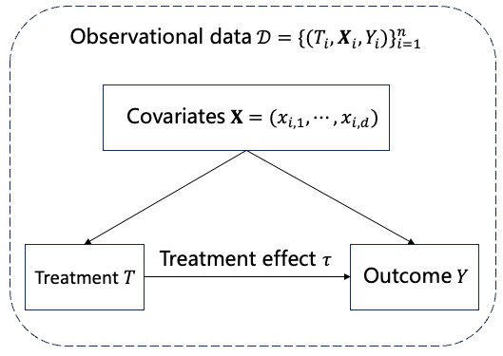
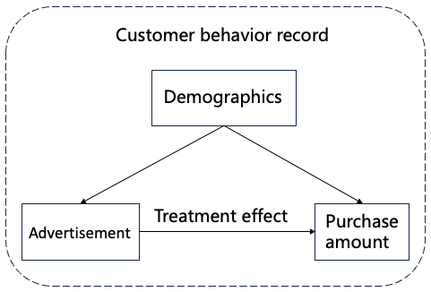
Background
Causal Inference: data analysis process aimed at examining the impact of treatment on outcome.
Notes:
Causal inference is a data analysis process that studies the effect of the treatment on the outcome.
Since randomized controlled trials are usually expensive and time-consuming
We focus on causal inference based on observational data.
For example, a marketer wants to analyze the effect of an advertisement on the promotion of customer purchases from behavior records.
因果推断是一种研究干预对结果影响的数据分析过程
由于随机对照试验通常比较昂贵和耗时，因此我们关注于基于观测数据的因果推断
例如，市场商人希望从顾客的行为记录中分析出广告对顾客购买金额的提升

Slide 3
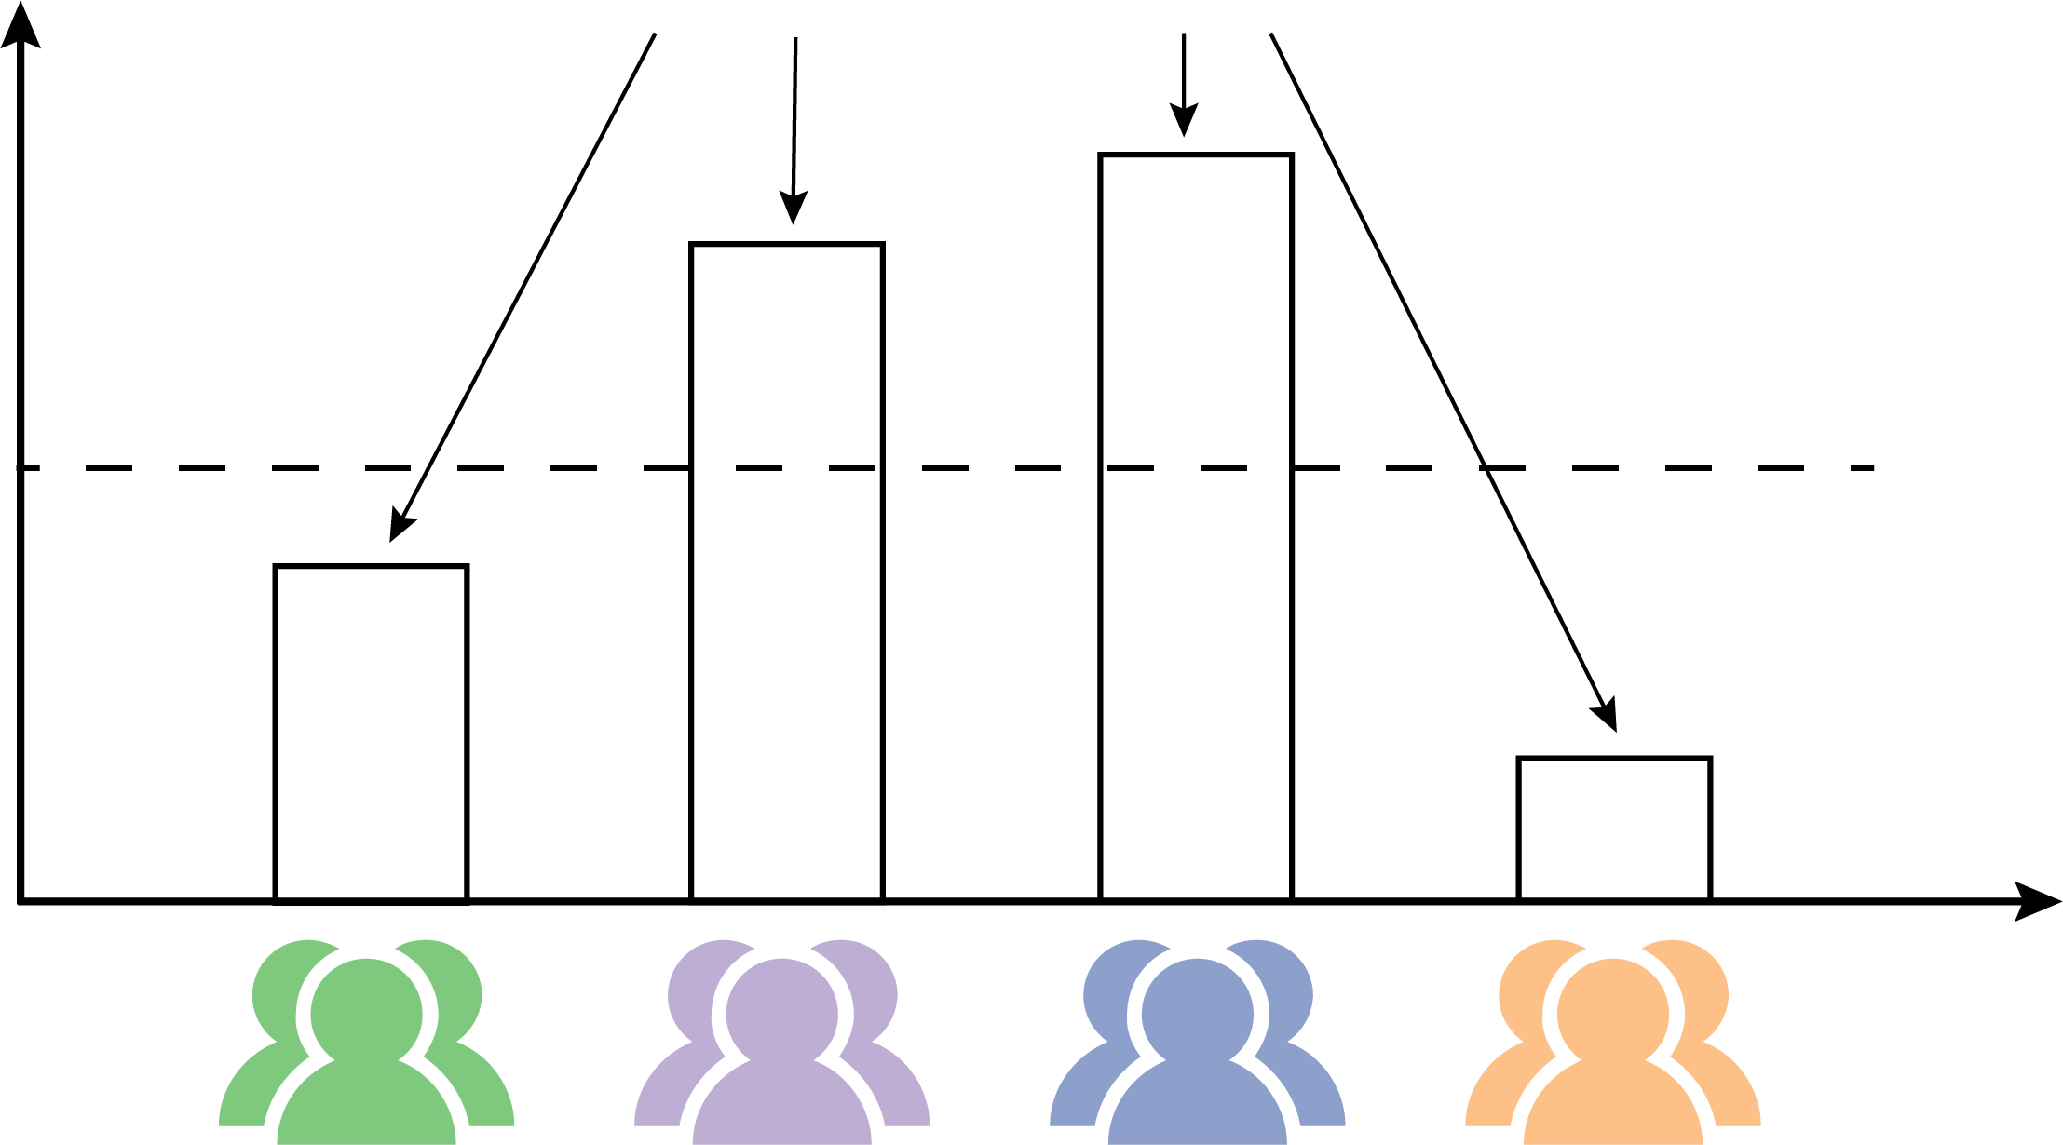
Problem
Heterogeneous treatment effect (HTE)
Conditional average treatment effect (CATE)
Precision medicine
Treatment effect
Average treatment effect (ATE)
Demographics
Targeted advertising
Fault diagnosis
Notes:
However, a single average treatment effect is misleading when the population contains heterogeneous subgroups.
For example, the same advertisement may have different marketing effects for people with different covariates such as demographics.
Discovering subgroups with significant treatment effects from observational data has many practical applications.
For example, it helps identify brand target customers in marketing, and discover high-risk patients for disease in medicine.
然而，当总体中包含着异质的子群时，单一的平均处理效应具有误导性
例如，同一种广告可能对于具有不同人口统计信息等协变量的人群具有不同的营销作用
从观测数据中发现那些具有显著处理效应等特征的子群，具有重要的实际应用价值
例如 xxx

Slide 4
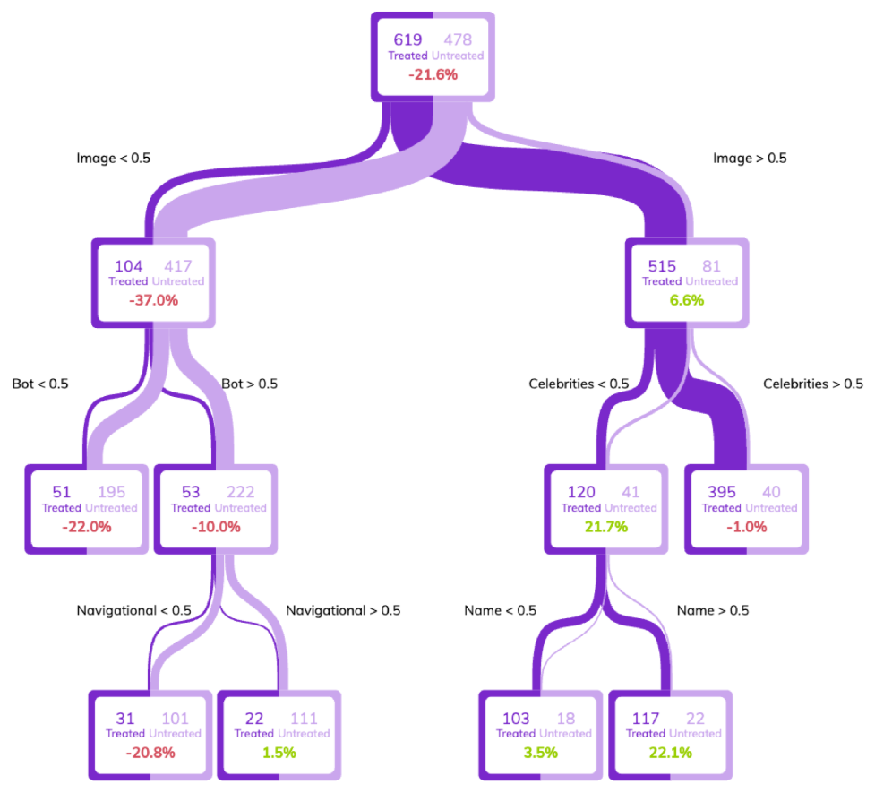
Related Work
HTE estimation
[Athey et al. 2016]
[Zhu et al. 2024]
Tree-based methods
Neural network-based methods
Interpretable but limited performance, with subgroups of varying effects
Accurate but lacks interpretability, no explicit description of subgroups
Notes:
For HTE estimation, there are two types of methods.
Tree-based methods are interpretable because subgroups can be defined by paths from roots to leaf nodes. However, the tree construction is usually greedy, so the performance is limited and does not directly yield optimal subgroups.
Neural network-based methods, on the other hand, can accurately estimate potential outcomes if well tuned, but due to the black-box nature, they usually cannot explicitly describe the subgroups.
已有的异质因果效应的估计方法主要有两类：基于树的方法，其可解释，因为可以用从根到叶子结点的路径来定义子群，然而树的构建过程通常是贪心的，导致性能有限，且并不直接得到最优的具有显著效应的子群。
而基于神经网络的方法，在很好调参后可以准确估计潜在结果或学习平衡的协变量表征，但由于黑盒性质，通常无法显式得到子群的描述。

Slide 5
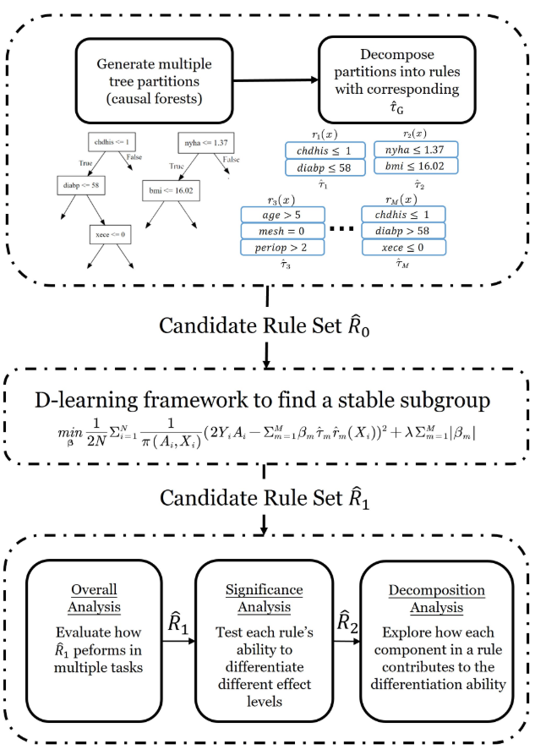
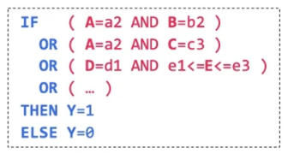
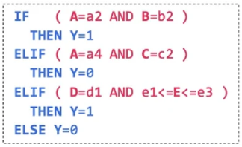
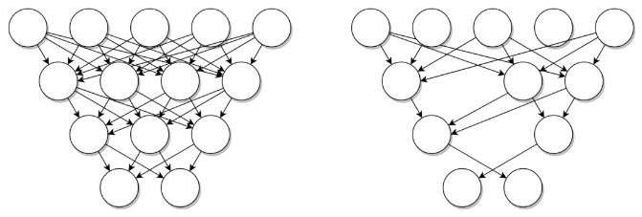
Related Work
Rule learning
Subgroup discovery
Rule: IF P THEN Q
Rule Discovery
Rule Selection
Rule set
Methodology
Rule Analysis
Rule list
[Wu et al. 2023]
Two-stage paradigm: Rule pre-mining and selection
Exhaustive and heuristic search
Interpretable but mostly focus on correlation rather than causation
Notes:
Some works use rule learning or subgroup discovery to find subgroups with interesting patterns.
Subgroups can be defined by interpretable feature values, however most methods focus only on correlation rather than causality.
还有一些工作使用规则学习或子群发现来找到具有有趣模式的子群。
子群可以被可解释的特征值所定义，然而它们通常只反应了相关性而非因果性

Slide 6
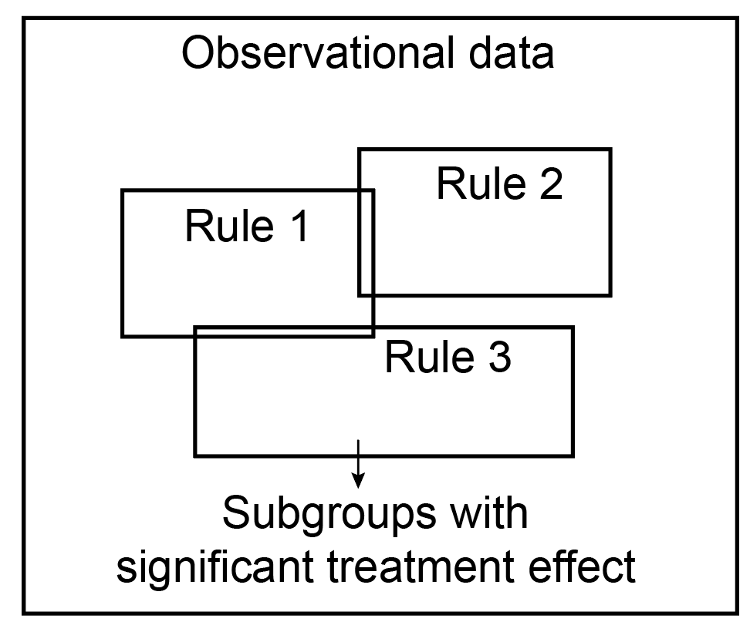
Our Idea
Causal rule: interpretability of rules for causality
Causal rule $R$: antecedent $α ⟹$ consequent $τ$
IF "age > 25 AND job == teacher" THEN effect = 2.3
Notes:
We want to help data analysts identify subgroups with significant treatment effects from observational data by combining the high accuracy of HTE estimates with the interpretability of the rules.
我们从统一优化的视角提出因果规则，希望通过结合异质因果效应估计的高准确性和规则的可解释性，来帮助数据分析师从观测数据中识别具有显著处理效应的子群。

Slide 7
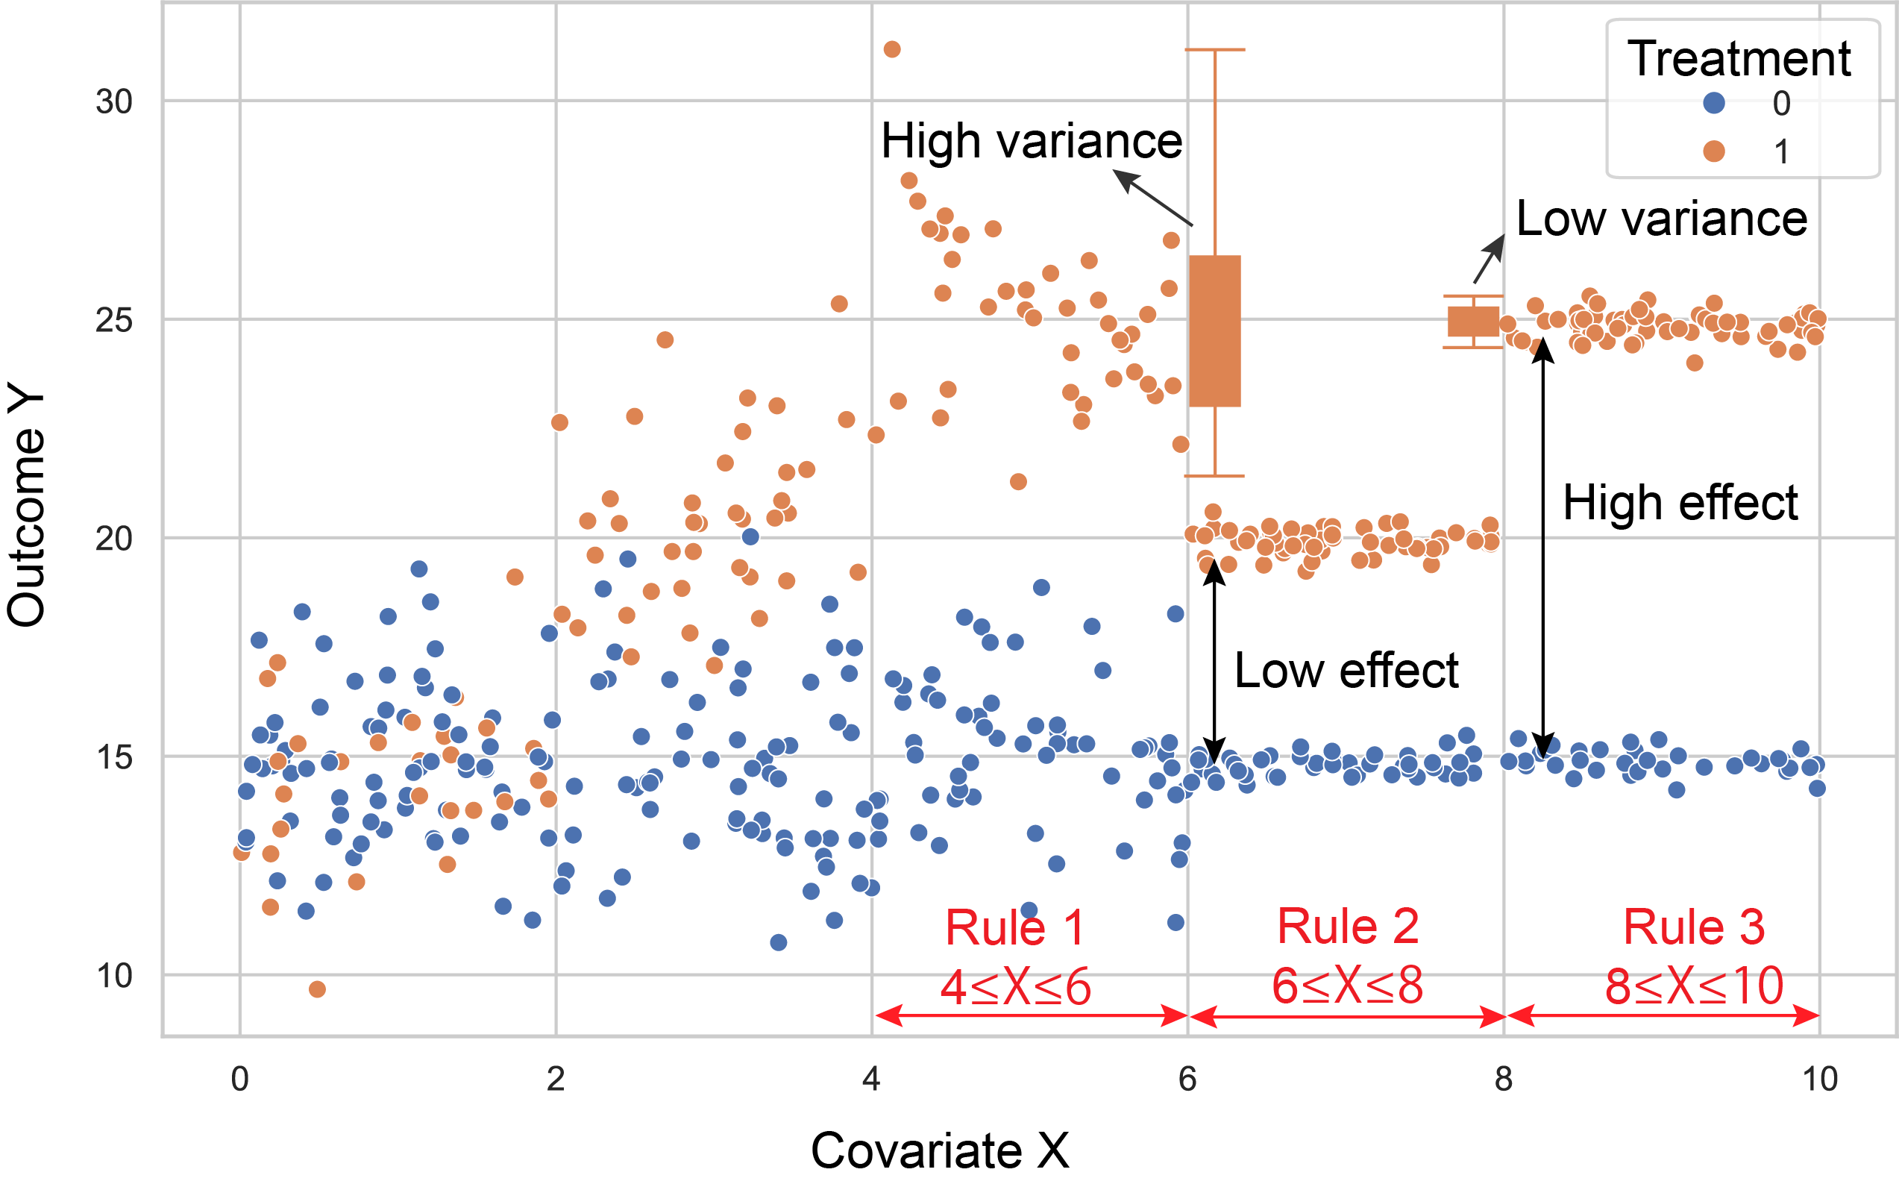
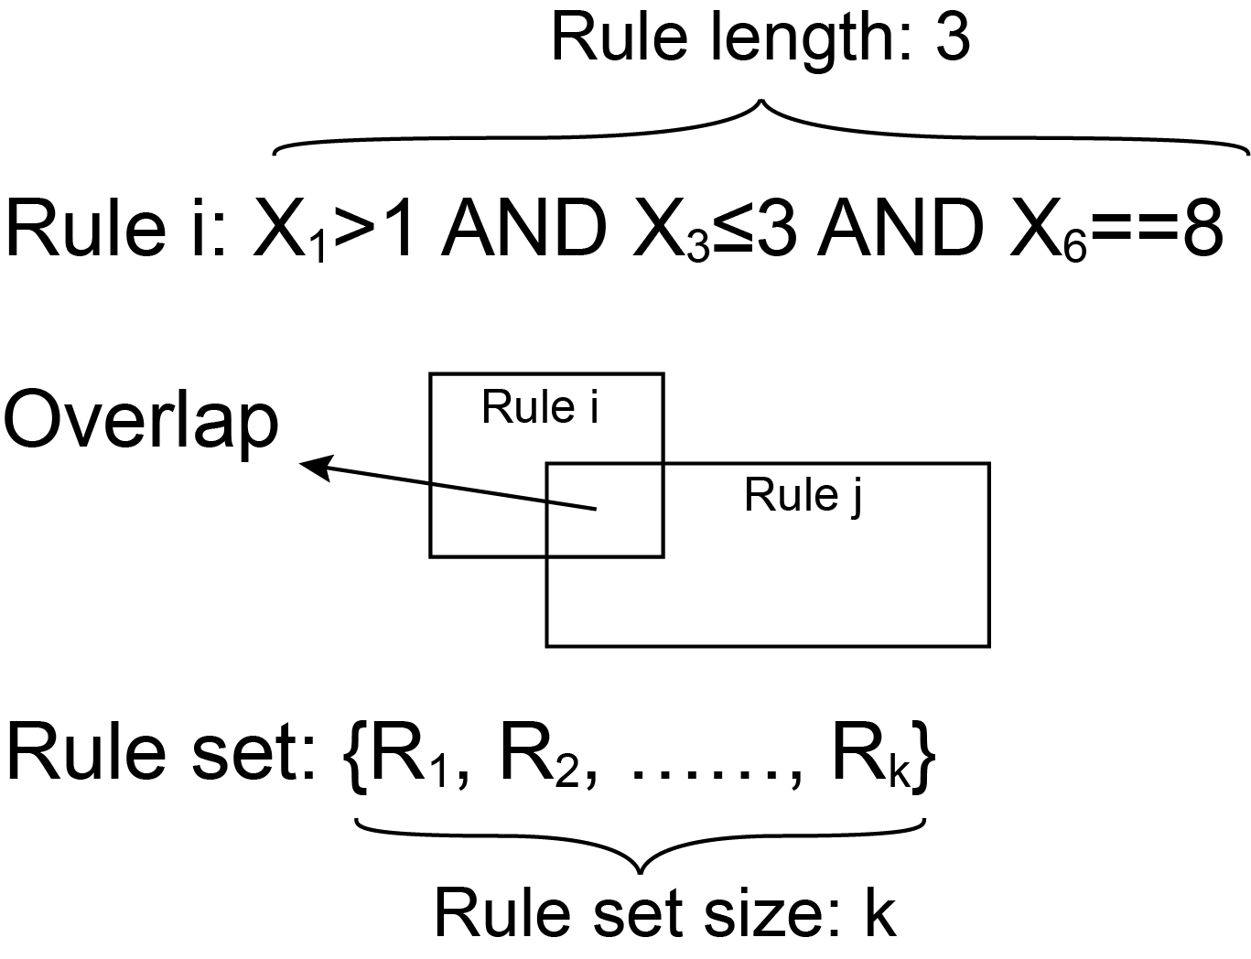
Challenges
Challenge 1
Data-space sanitization
Effects-variance tradeoffs and readability constraints
Notes:
However, there are still two challenges:
First, multiple factors need to be considered, such as the trade-off between effect and outcome variance and the readability of rules.
The figure below shows a toy example, there is only one covariate x, and the change in the outcome y between the treatment (orange) and control (blue) group can be informally thought of as the treatment effect.
Rule 3 has a higher effect and lower variance, which is better than Rule 1 with the same effect but high variance, and Rule 2 with a low effect.
In addition, the length of the rules, the overlap between the rules, and the size of the rule set will also affect the user's understanding of the results.
然而，还存在着两个挑战：首先，考量因素众多，例如需要考虑效应和结果方差的权衡和子群的可读性等。
对于效果和方差的权衡，下图展示了一个 toy examples，There is only one covariate, and the
change in the outcome between the treatment and control group can
be informally thought of as the treatment effect. 规则 3 覆盖的数据具有更高的效应和更低的方差，优于具有相同效应但高方差的规则 1，以及低效应的规则 2。
另外，规则的长度，规则间的重叠以及规则集的大小也会影响用户对于结果的理解

Slide 8
Challenges
Challenge 1
Data-space sanitization
Challenge 2
Effects-variance tradeoffs and readability constraints
Combinatorial explosion of candidate subgroups
age>25 ∧ job==teacher
Covariates
Values
Notes:
Second, it is non-trivial to efficiently find the desired subgroups from the combinatorial explosion of candidates.
The subgroups can be described by the conjunction normal form of “covariate-value” pairs, so the potential feasible space is huge, which poses a challenge to the computational efficiency.
第二，如何高效地从组合爆照的候选子群中找到符合的是不平凡的。
子集可以通过“协变量-值” 对的合取范式来描述，因而潜在可行空间巨大，对计算效率提出了挑战。

Slide 9
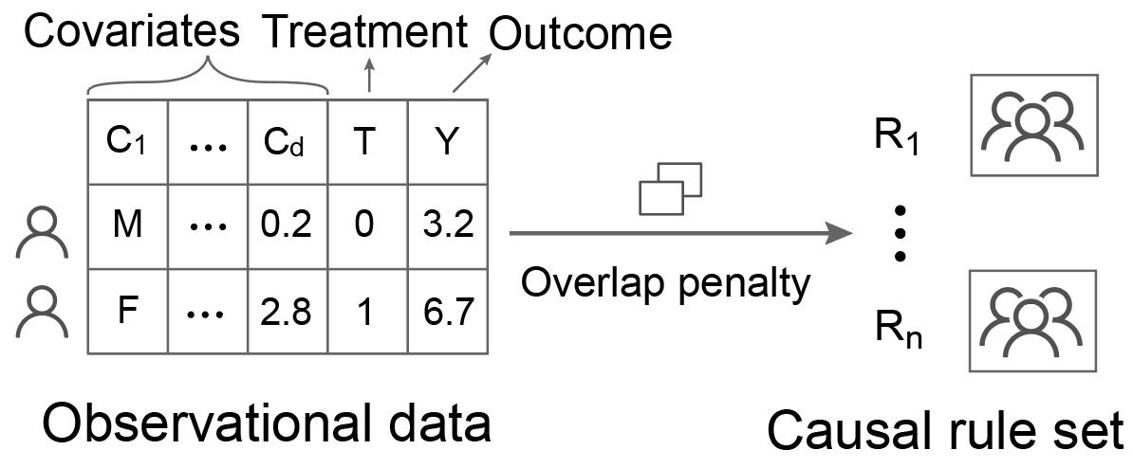
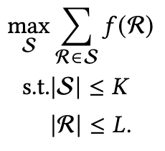
Our Solution
Data-space sanitization
Challenge 1
Effects-variance tradeoffs and readability constraints
Formalized as a discrete optimization problem
Notes:
To this end, from the perspective of unified optimization, we first model causal rule learning as a multi-objective discrete optimization problem.
为此，我们首先从统一优化的视角出发，将因果规则学习建模成了一个多目标的离散优化问题

Slide 10
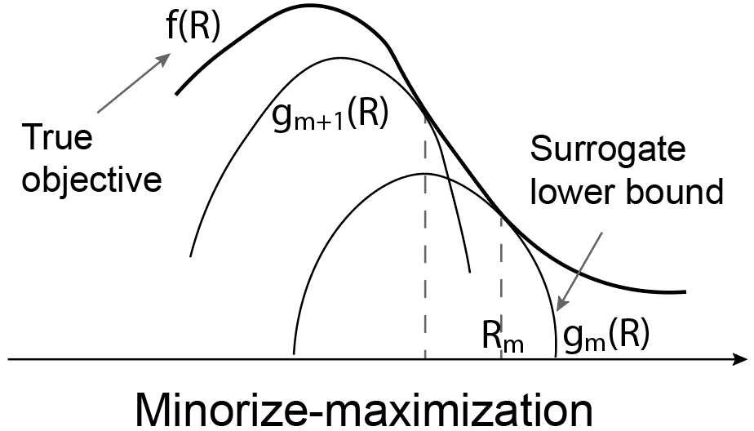
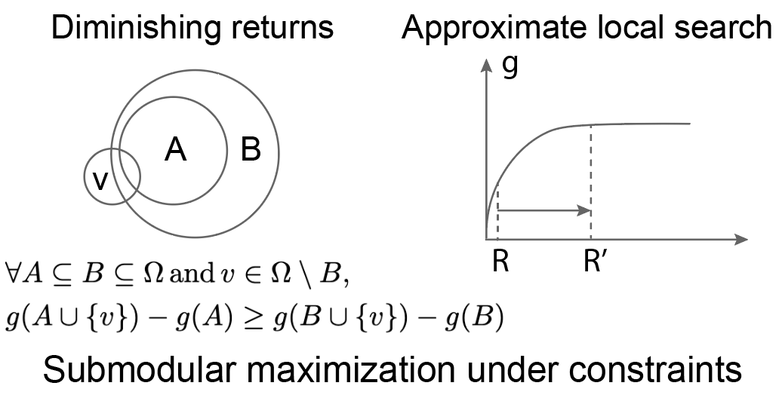
Our Solution
Challenge 1
Challenge 2
Effects-variance tradeoffs and readability constraints
Combinatorial explosion of candidate subgroups
Formalized as a discrete optimization problem
Efficient algorithm based on minorize-maximization and submodular optimization
Notes:
Then an efficient algorithm based on minorize-maximization and submodular optimization is proposed to discover rules with significant treatment effects.
然后提出了一种高效的基于最小化最大化和次模优化的算法来发现具有显著因果效应的规则。

Slide 11
Preliminaries
Data-space sanitization
Causal inference under the potential outcome (PO) framework
Propensity score: $e\left(X\right)=P(T=1|X=x)$
Inverse probability weight: $w_{i}=\frac{T_{i}}{e_{i}}+\frac{1−T_{i}}{1−e_{i}}$
Treatment effect: $τ=\frac{\sum_{i;T_{i}=1}{w_{i}}Y_{i}}{\sum_{i;T_{i}=1}{w_{i}}}−\frac{\sum_{i;T_{i}=0}{w_{i}}Y_{i}}{\sum_{i;T_{i}=0}{w_{i}}}$
Outcome variance: $σ^{2}=\frac{\sum_{i;T_{i}=1}{w_{i}}{(Y_{i}−{\overline{Y}}_{w})}^{2}}{\sum_{i;T_{i}=1}{w_{i}}}$
Notes:
Let’s first introduce some preliminary knowledge.
We conduct causal inference based on observational data under the framework of potential outcomes.
Through inverse probability weighting, we can obtain the treatment effect and variance of the subgroup covered by the causal rule.
首先先介绍一下预备知识。
我们在潜在结果框架下进行基于观测数据的因果推断，通过逆概率加权来得到规则覆盖的子群的处理效应和方差。

Slide 12
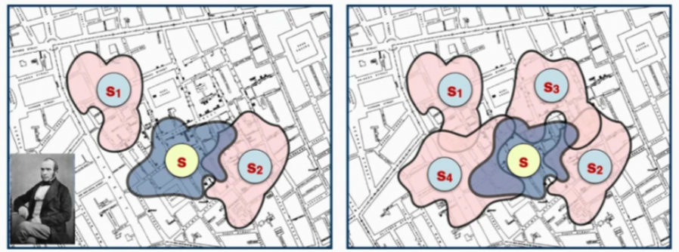
Preliminaries
Data-space sanitization
Submodular and supermodular functions
Submodular: Diminishing returns
Supermodular: Increasing Returns
Like the convexity in continuous optimization, submodularity is a good property in discrete optimization
$$∀A⊆B⊆Ω \text{and} s∈Ω∖B$$
$$f\left(A∪\left\{s\right\}\right)−f(A)≥f\left(B∪\left\{s\right\}\right)−f(B)$$
$$A=\left\{s_{1},s_{2}\right\}$$
$$B=\left\{s_{1},s_{2},s_{3},s_{4}\right\}$$
Notes:
In algorithm design, we use submodular and supermodular functions.
Submodular refers to "diminishing returns", that is, as the existing set increases, the benefits of adding new elements to this set become less and less.
Supermodular is the opposite, describing "increasing returns".
在算法设计中，我们使用了次模和超模函数。
次模是指“边际收益递减”，即随着已有集合的增加，想这个集合中添加新元素所带来的收益越来越少。
超模则与之相反，描述的是“边际效益递增”。

Slide 13
Problem Formulation
Data-space sanitization
The profit of a single causal rule: $\frac{τ_{R}}{λσ_{R}^{2}}$
Objective function: $f\left(R\right)=\log{\frac{\sum_{i;T_{i}=1}{w_{i}}Y_{i}}{\sum_{i;T_{i}=1}{w_{i}}}}−\log{\frac{\sum_{i;T_{i}=0}{w_{i}}Y_{i}}{\sum_{i;T_{i}=0}{w_{i}}}}−λ\log{\frac{\sum_{i;T_{i}=1}{w_{i}}{(Y_{i}−{\overline{Y}}_{w})}^{2}}{\sum_{i;T_{i}=1}{w_{i}}}}$
Causal rule set learning can be modeled as an optimization problem:
$$\begin{matrix}\max_{S}{\sum_{R∈S}{f(R)}} \\ \text{s}\text{.}\text{t}\text{.} |S|≤K \\ |R|≤L\end{matrix}$$
Notes:
We first define the profit of causal rules, i.e., we want large effects and small variance.
For optimization purposes, we take the logarithm of the objective.
Combined with constraints such as rule length and rule set size, we model causal rule set learning as a discrete optimization problem.
我们希望因果规则对应的处理效应尽量大，方差尽量小，因此可以得到单条因果规则的收益，为了方便优化，我们对其取了 log。
考虑效应方差，以及规则长度和规则集大小等多种因素，我们可以将因果规则集学习建模为一个优化问题。

Slide 14
CURLS Algorithm
Data-space sanitization
Causal Rule Learning for Subgroups with Significant Treatment Effect
Notes:
To solve the above optimization problem, we proposed CURLS, namely Causal Rule Learning for Subgroups with Significant Treatment Effect.
It consists of three sub-steps from top to bottom.

Slide 15
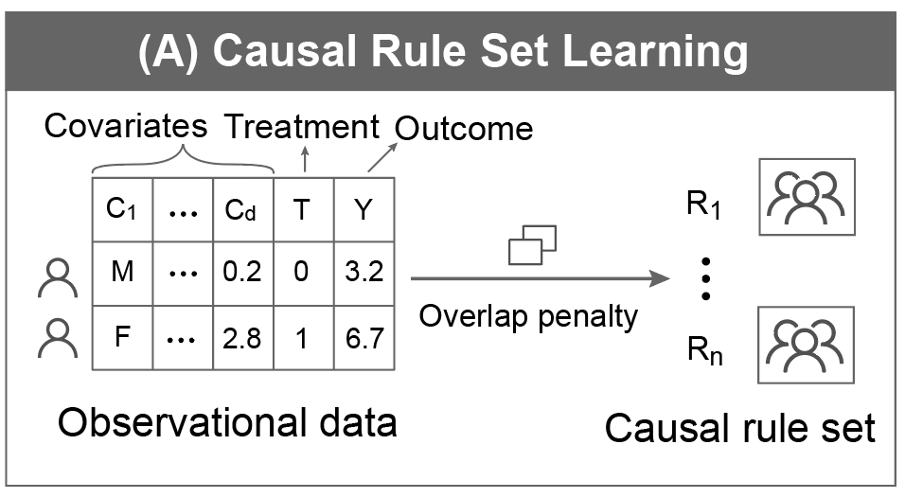
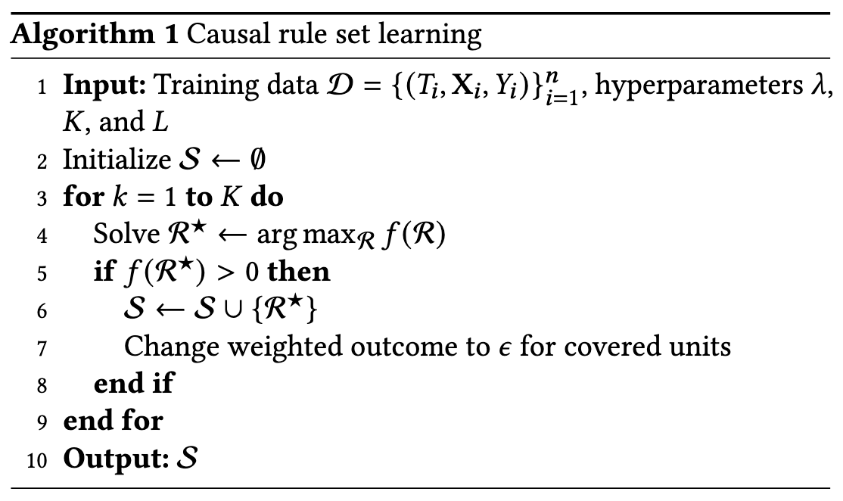
CURLS: Causal Rule Set Learning
Data-space sanitization
Previous sequential covering paradigms: removing data covered by previous rules and learning a new rule → easily result in overlapping rules
Overlap penalty: set the weighted outcome of the covered units to a smaller value → minimize the case where a unit is covered by multiple rules
Notes:
For rule sets, reducing the overlap between rules helps improve readability. The previous sequential coverage paradigm for rule sets is to learn a new rule by deleting the covered data, but this easily leads to overlapping rules.
Therefore, we introduce the overlap penalty, which reduces the contribution of the repeatedly covered data units to the treatment effect, thereby improving the readability of the rule set.
对于规则集，减少其中规则之间的重叠有助于提高可读性，之前学习因果规则集的序列覆盖范式是通过在删去已覆盖的数据上来学习新的规则，但这样很容易出现重叠的规则。
因此，我们引入了重叠惩罚，重复覆盖的数据单元对于效应的贡献减弱，从而提高规则集的可读性。

Slide 16
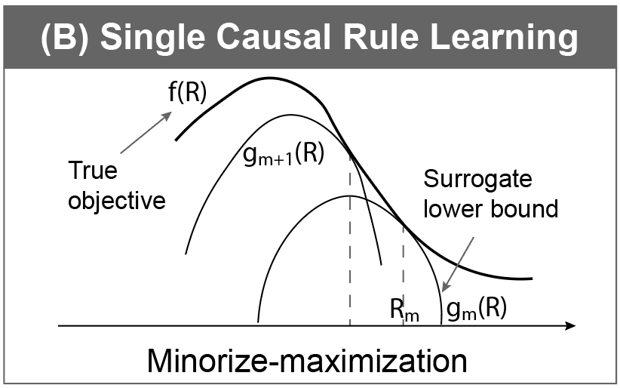
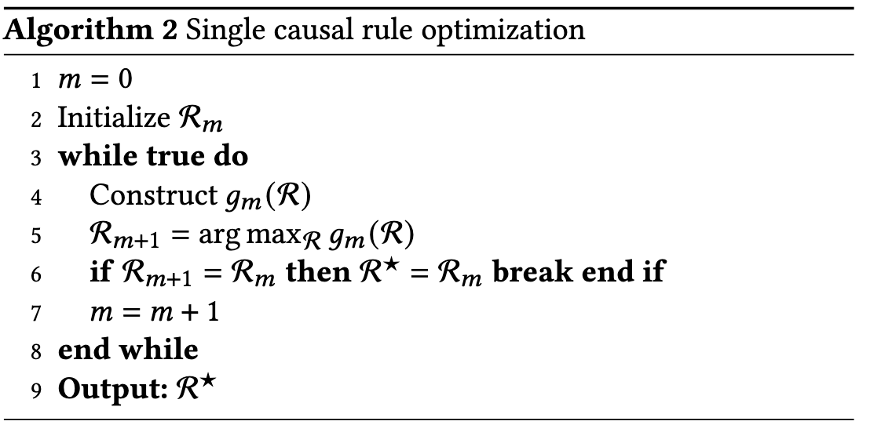
CURLS: Single Causal Rule Optimization
Data-space sanitization
The original objective $f(R)$ is complex and difficult to optimize
Minorize-maximization framework: a rule is improved by iteratively optimizing the surrogate lower bound of the original objective.
Notes:
For the learning of a single causal rule, since the original objective f(R) is complex and difficult to optimize, we adopt a minorize-maximization framework to gradually improve the current rule by optimizing a lower bound g(R) of the current objective.

Slide 17
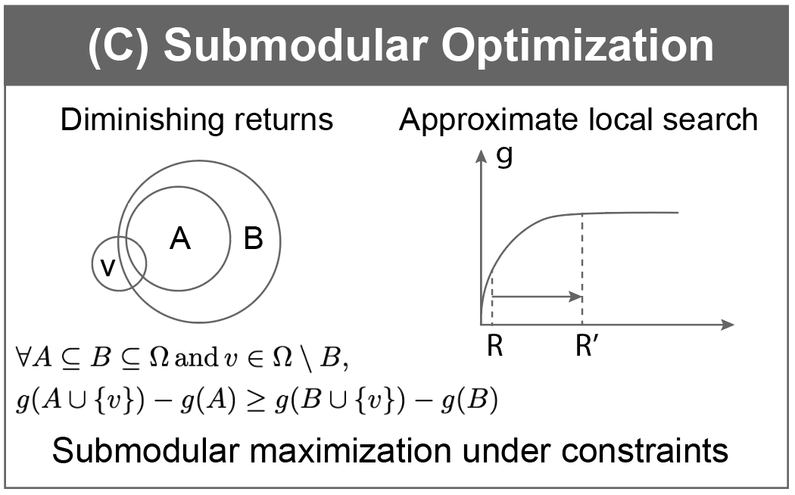
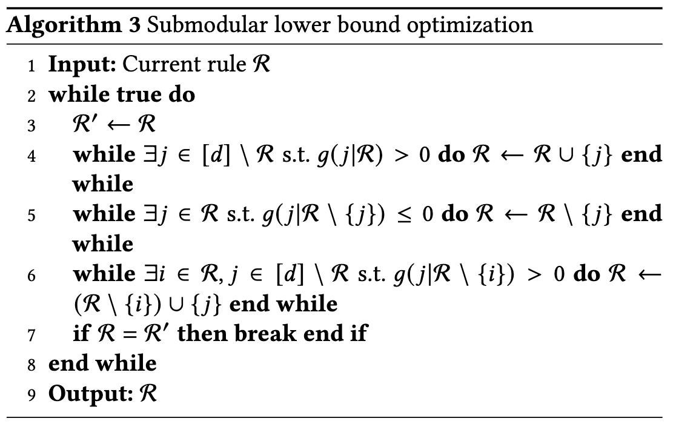
CURLS: Submodular Lower Bound Optimization
Data-space sanitization
We prove that $f(R)$ has a submodular lower bound $g(R)$ (see the paper for more details)
For g(R), the optimum can be reached by efficient submodular optimization algorithm (approximate local search).
Notes:
We further prove that the original objective f(R) has a submodular lower bound g(R) that is easier to optimize.
So efficient submodular optimization algorithms (such as approximate local search) can be used to obtain the optimum.
Please refer to the paper for more details.
我们进一步证明，原始目标 f(R) 存在一个更容易被优化的具有次模性质的下界g(R)
因此可以利用高效的次模优化算法（如近似局部搜索）来获取最优点。
请参考论文获取更多细节。

Slide 18
Evaluation
Quantitative experiments
Datasets: synthetic and semi-synthetic
Baselines
tree-based CATE methods: Causal Tree (CT), Causal Forest (CF)
causal rule learning methods: Causal Rule Ensemble (CRE)
subgroup discovery methods: Decision Tree (DT), Pysubgroup (PYS)
rule learning methods: Boolean Decision Rules via Column Generation (BRCG)
In supplementary experiments, we also compare black-box causal heterogeneity and uplift models: double machine learning, doubly robust, and orthogonal random forest
Notes:
We conduct quantitative experiments to demonstrate that the causal rules discovered by CURLS are able to cover those subgroups with significant treatment effects.
Due to the lack of ground-truth for CATE in real-world data, we perform method comparisons on synthetic and semi-synthetic datasets.
We selected different types of baselines, such as tree-based CATE methods, subgroup discovery and rule learning methods. In the supplementary experiments, we also compared the black-box causal heterogeneous model and the uplift model.
我们通过定量实验来证明 CURLS 发现的因果规则能够覆盖那些具有显著因果效应的子群。由于实际数据中缺乏 CATE 的 groundtruth，因此我们在合成和半合成数据集上进行方法比较。
我们选择了不同类型的基线，例如基于树的CATE 方法，子群发现和规则学习方法，在补充材料中，我们还比较了黑盒的因果异质模型和 uplift 模型

Slide 19
Evaluation
Quantitative experiments
Metrics
Estimated CATE $\hat{τ}$
True CATE (mean value of ITE within subgroup) $τ$
Outcome variance $σ^{2}$
The precision in the estimation of heterogeneous effects: $\text{PEHE} =\sqrt{\frac{1}{n}\sum_{i=1}^{n}{{(\hat{τ}\left(x_{i}\right)−τ(x_{i}))}^{2}}}$
The mean absolute percentage error: $\text{MAPE} =\frac{1}{n}\sum_{i=1}^{n}{\left|\frac{\hat{τ}\left(x_{i}\right)−τ(x_{i})}{τ(x_{i})}\right|}$
Average length of rule antecedent
Average overlap between pairs of rules
Rule set coverage
Implement detail
5-fold cross-validation
Tuning parameters based on Bayesian optimization
Notes:
We selected metrics from the perspectives of effect, variance, inference precision, and rule interpretability to comprehensively evaluate the effectiveness of methods.
5-fold cross-validation and Bayesian optimization are used to tune parameters.

Slide 20
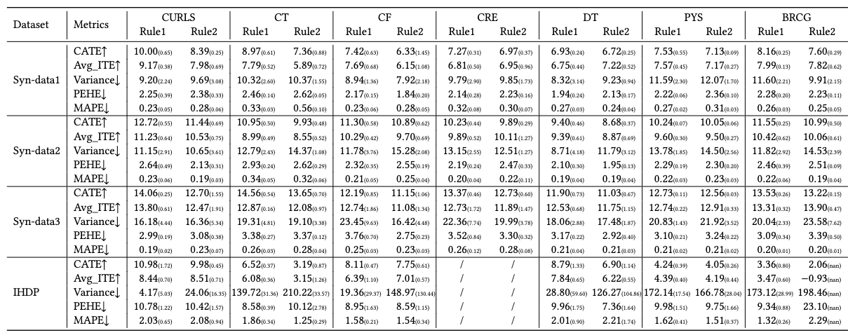
Evaluation
Quantitative experiments
Compared to the baseline, CURLS improves the estimated and true CATE by 16.1% and 13.8%, reduces the variance by 12.0%
Notes:
Experimental results show that compared to the baseline, CURLS improves the estimated and true CATE by 16.1% and 13.8%, reduces the variance by 12.0%

Slide 21
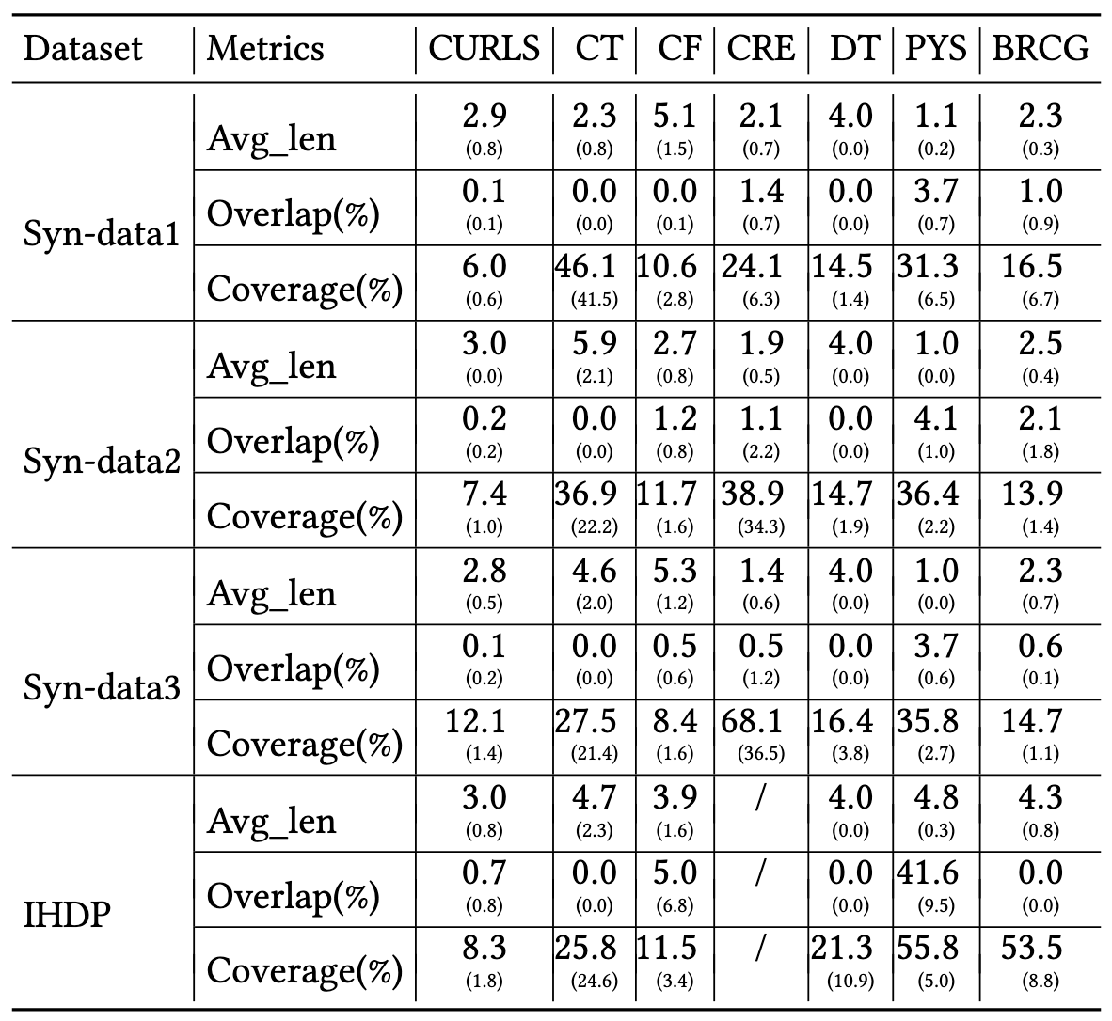
Evaluation
Quantitative experiments
Compared to the baseline, CURLS improves the estimated and true CATE by 16.1% and 13.8%, reduces the variance by 12.0%
Maintains similar or higher rule interpretability.
Notes:
The average rule length of CURLS is smaller than that of tree-based causal trees and causal forests.
The rule overlap and coverage of CURLS are also maintained at a reasonable level, which is helpful for user understanding.

Slide 22
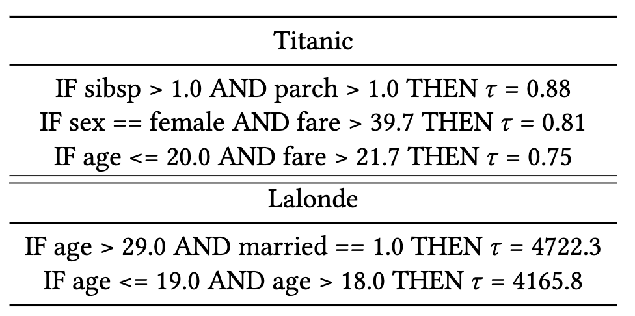
Evaluation
Qualitative case studies: meaningful and reasonable rules
Titanic: Upgrading has a positive effect on improving the quality of family passengers, women and children
Lalonde (part of the Jobs dataset): Vocational training helps increase the income of married people aged 29 and over and young people aged 18-19
Notes:
We also conduct quantitative experiments on real data and find that CURLS is able to discover meaningful and reasonable causal rules.
For example, for the Titanic dataset, the first rule shows that upgrading to a higher class improves survivability for passengers with more family members, who may be more willing to aid each other.
The second and third rules correspond to the fact that women and children who pay higher ticket fees are more likely to be rescued due to the abundant rescue resources in the higher class and the “women and children first” policy.

Slide 23
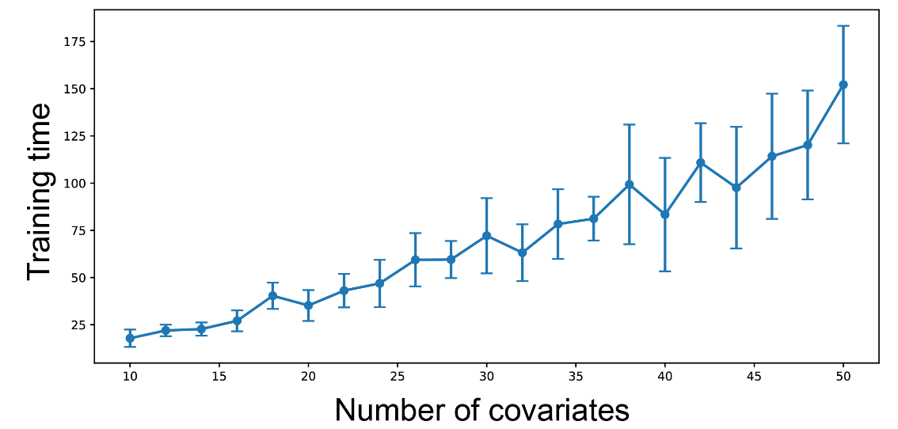
Discussion
Implications
Interpretable CURLS is suitable for scenarios that require causal support for decision making, such as education and public administration
Scalability
Complexity is dominated by local search and is linear with the number of covariates
Notes:
Scalability experiments show that the complexity of CURLS is mainly dominated by local search and is linear with the number of covariates

Slide 24
Discussion
Limitations and future work
Improve the quality of solutions by using neural combinatorial optimization
Richer logical connectives
Consider complex causal settings such as multiple interventions and unobserved variables
Notes:
In the future, we will try to improve the quality of solutions through neural combinatorial optimization, introduce richer logical connectives, and consider more complex causal scenarios.

Slide 25
Conclusion
Contributions
Formalize the discovery of causal rules with significant treatment effects into a discrete optimization problem
Efficient solution by constructing an approximate submodular lower bound
Quantitative and qualitative evaluations demonstrate CURLS's ability to discover significant and interpretable causal rules
Notes:
In summary, our contributions are:
First, we formalize the discovery of causal rules with significant treatment effects into a discrete optimization problem
Second, we propose an efficient solution by constructing an approximate submodular lower bound.
Third, quantitative and qualitative evaluations demonstrate CURLS's ability to discover significant and interpretable causal rules

Slide 26
Acknowledgments
Paper: https://arxiv.org/abs/2407.01004
Code: https://osf.io/zwp2k/
Contact: zhoujiehui@zju.edu.cn
All the reviewers for their constructive comments
National Natural Science Foundation of China (62132017)
Zhejiang Provincial Natural Science Foundation of China (LD24F020011)
Alibaba Research Intern Program
Notes:
Thank you！

